Slide 1
Adids SHOE BRAND Quality, Comfort and Style

Slide 2
TABLE OF CONTENTS
01
04
02
05
03
06
INTRODUCTION
What We Want to Achieve?
ABOUT US
Why Choose Us?
OUR GOALS
CODE OVERVIEW

Slide 3
01
INTRODUCTION

Slide 4

INTRO TO ADIDS STORE
Welcome to our shoe store! Established in [2024], our store has been dedicated to offering high-quality, stylish, and comfortable footwear. Over the years. Our unique selling points include exclusive designs, exceptional customer service, and competitive pricing.

Slide 5
About Us
Our store is dedicated to providing high-quality, stylish, and comfortable shoes for all occasions. Our mission is to become the go-to destination for footwear that combines fashion with functionality.

Slide 6
Our Goals
Short-term goals:
Increase customer base
Expand product range
Long-term goals:
Establish a strong brand presence
Innovate in shoe design
Vision for the future:
- Be the leader in the shoe industry

Slide 7
What We Want to Achieve?
Our primary focus is on achieving the highest level of customer satisfaction by providing top-notch products and services. We aim to expand our market reach and introduce innovative designs that set us apart in the industry.

Slide 8
QUALITY
Comfort
Style
High-Grade Materials:
We use premium materials sourced from the best suppliers to ensure durability and longevity.
Advanced Technology:
We incorporate the latest technology in our shoe designs, such as breathable fabrics and shock-absorbing soles.
Trendy Designs:
We stay ahead of fashion trends to offer a diverse collection of stylish shoes that appeal to various tastes.

Slide 9
Why Choose Us?
High-quality products
Competitive pricing
Unique and stylish designs
Exceptional customer service

Slide 10
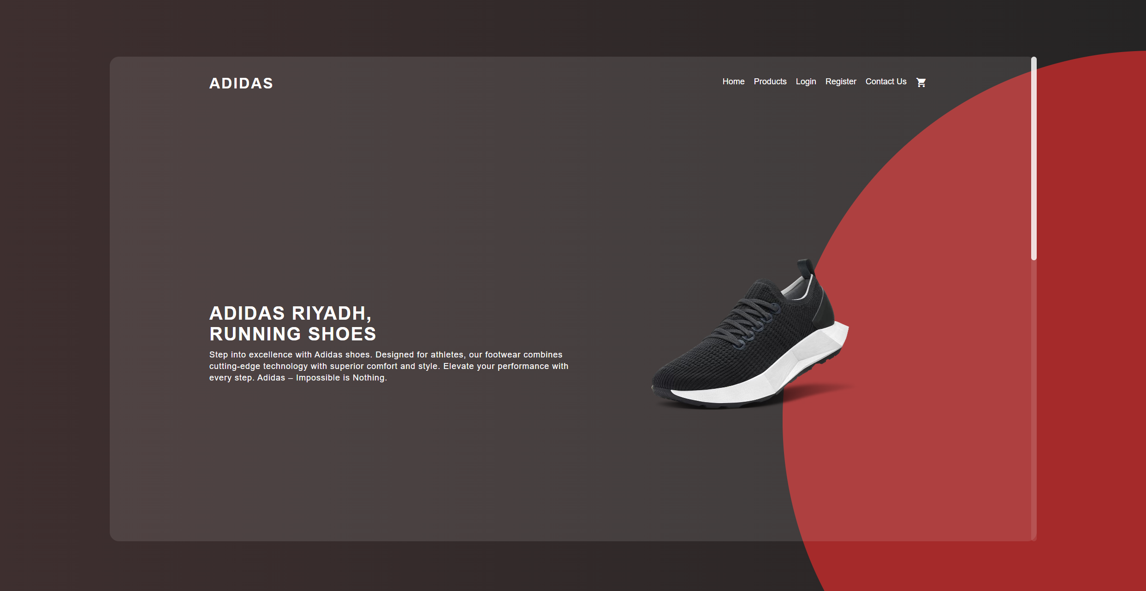
Code Overview
Our backend system is built using Node.js and Express, providing a robust and scalable platform for our operations. We use MongoDB for data storage,
ensuring efficient and reliable management of product and order information.
The codebase includes various functionalities such as user authentication, product management, order processing, and more. We have implemented secure practices to protect customer data and ensure smooth transactions.

Slide 11
Conclusion
Excellence: Commitment to quality, comfort, and style.
Customer Focus: Exceptional service and satisfaction.
Innovation: Modern designs and advanced technologies.
Join Us: Explore our collection and experience the difference.

Slide 12
THANKS
for listening.

